Slide 1
Introduction to Machine Learning

Slide 2
Week goals
What is machine learning?
What problems does machine learning solve?
Introduce the main definitions

Slide 3
What is Machine Learning?

Slide 4




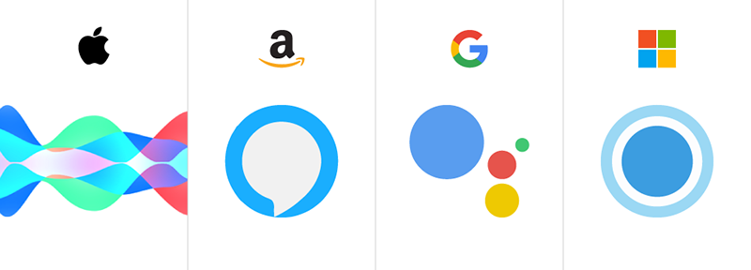


Machine Learning is everywhere!
Translation
https://upload.wikimedia.org/wikipedia/commons/d/d7/Google_Translate_logo.svg
https://upload.wikimedia.org/wikipedia/commons/thumb/1/1a/Yandex_Translate_icon.svg/1920px-Yandex_Translate_icon.svg.png
Recommendations
https://upload.wikimedia.org/wikipedia/commons/thumb/0/09/YouTube_full-color_icon_%282017%29.svg/640px-YouTube_full-color_icon_%282017%29.svg.png
https://upload.wikimedia.org/wikipedia/commons/thumb/1/19/Spotify_logo_without_text.svg/1024px-Spotify_logo_without_text.svg.png
Voice Assistant
https://dribbble.com/shots/3115808-Virtual-Assistants
Advertisement
https://ru.m.wikipedia.org/wiki/Файл:Yandex_Direct_icon.svg
https://en.wikipedia.org/wiki/File:Google_Ads_logo.svg

Slide 5
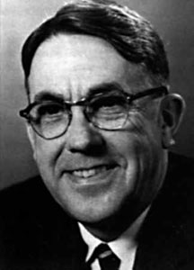
Machine Learning
"Field of study that gives computers the ability to learn without being explicitly programmed"
Arthur Samuel
https://en.wikipedia.org/wiki/File:This_is_the_photo_of_Arthur_Samuel.jpg

Slide 6
Sorting
Sort this numbers in ascending order
1
4
6
3
2

Slide 7
Sorting
Sort this numbers in ascending order
1
4
6
3
2
Bubble sort
1
4
6
3
2

Slide 8
Sorting
Sort this numbers in ascending order
1
4
6
3
2
Bubble sort
1
4
6
3
2

Slide 9
Sorting
Sort this numbers in ascending order
1
4
6
3
2
Bubble sort
1
4
6
3
2

Slide 10
Sorting
Sort this numbers in ascending order
1
4
6
3
2
Bubble sort
1
4
6
3
2

Slide 11
Sorting
Sort this numbers in ascending order
1
4
6
3
2
Bubble sort
1
4
6
3
2

Slide 12
Sorting
Sort this numbers in ascending order
1
4
6
3
2
Bubble sort
1
4
6
3
2

Slide 13
Sorting
Sort this numbers in ascending order
1
4
6
3
2
Bubble sort
1
4
3
6
2

Slide 14
Sorting
Sort this numbers in ascending order
1
4
6
3
2
Bubble sort
1
4
3
6
2

Slide 15
Sorting
Sort this numbers in ascending order
1
4
6
3
2
Bubble sort
1
4
3
6
2

Slide 16
Sorting
Sort this numbers in ascending order
1
4
6
3
2
Bubble sort
1
4
3
6
2

Slide 17
Sorting
Sort this numbers in ascending order
1
4
6
3
2
Bubble sort
1
4
3
2
6

Slide 18
Sorting
Sort this numbers in ascending order
1
4
6
3
2
Bubble sort
1
4
3
2
6

Slide 19
Sorting
Sort this numbers in ascending order
1
4
6
3
2
Bubble sort
1
4
3
2
6

Slide 20
Sorting
Sort this numbers in ascending order
1
4
6
3
2
Bubble sort
1
4
3
2
6

Slide 21
Sorting
Sort this numbers in ascending order
1
4
6
3
2
Bubble sort
1
4
3
2
6

Slide 22
Sorting
Sort this numbers in ascending order
1
4
6
3
2
Bubble sort
1
3
4
2
6

Slide 23
Sorting
Sort this numbers in ascending order
1
4
6
3
2
Bubble sort
1
3
4
2
6

Slide 24
Sorting
Sort this numbers in ascending order
1
4
6
3
2
Bubble sort
1
3
4
2
6

Slide 25
Sorting
Sort this numbers in ascending order
1
4
6
3
2
Bubble sort
1
3
4
2
6

Slide 26
Sorting
Sort this numbers in ascending order
1
4
6
3
2
Bubble sort
1
3
2
4
6

Slide 27
Sorting
Sort this numbers in ascending order
1
4
6
3
2
Bubble sort
1
3
2
4
6

Slide 28
Sorting
Sort this numbers in ascending order
1
4
6
3
2
Bubble sort
1
3
2
4
6

Slide 29
Sorting
Sort this numbers in ascending order
1
4
6
3
2
Bubble sort
1
3
2
4
6

Slide 30
Sorting
Sort this numbers in ascending order
1
4
6
3
2
Bubble sort
1
3
2
4
6

Slide 31
Sorting
Sort this numbers in ascending order
1
4
6
3
2
Bubble sort
1
3
2
4
6

Slide 32
Sorting
Sort this numbers in ascending order
1
4
6
3
2
Bubble sort
1
2
3
4
6

Slide 33
Sorting
Sort this numbers in ascending order
1
4
6
3
2
Bubble sort
1
2
3
4
6

Slide 34
Sorting
Sort this numbers in ascending order
1
4
6
3
2
Bubble sort
1
2
3
4
6

Slide 35
Sorting
Sort this numbers in ascending order
1
4
6
3
2
Bubble sort
1
2
3
4
6

Slide 36
How fast the object will hit the ground?
We drop an object from height $h$.
How long will it take to fall?

Slide 37
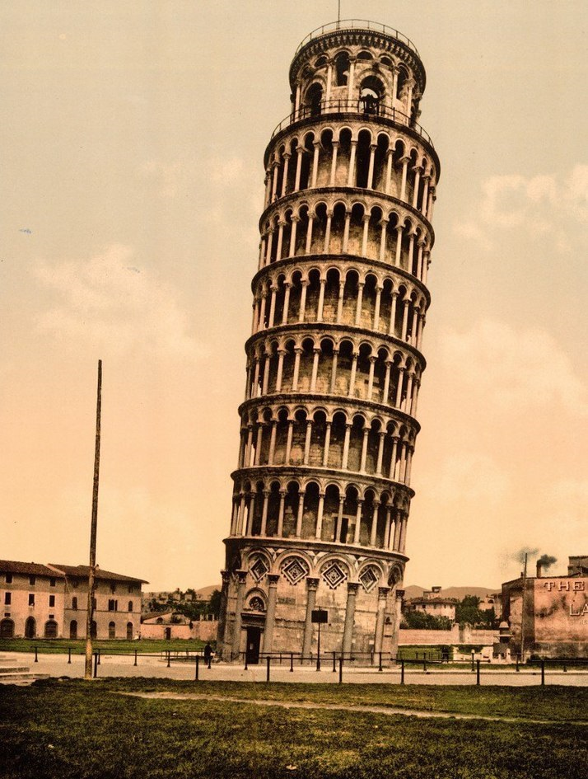
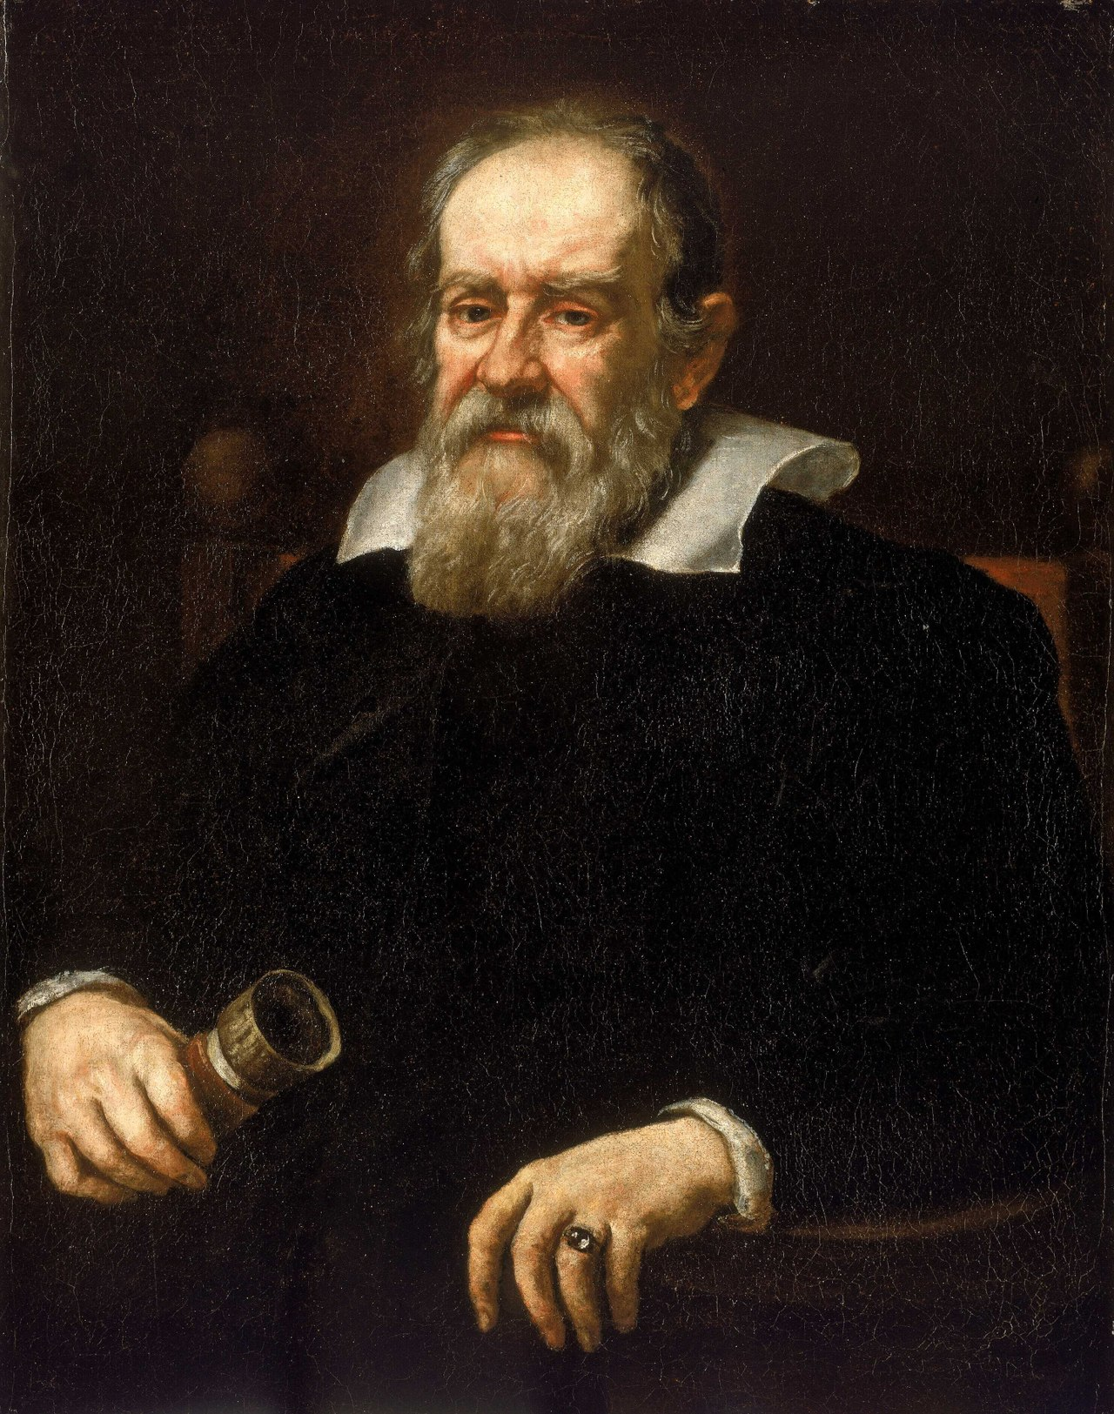
How fast the object will hit the ground?
We drop an object from height $h$.
How long will it take to fall?
In 16th century, Galileo Galilei dropped balls from the Tower of Pisa to get the answer.
https://en.wikipedia.org/wiki/Galileo_Galilei#/media/File:Galileo_Galilei_(1564-1642)_RMG_BHC2700.tiff
https://blog.history.ac.uk/files/2022/05/714px-Leaning_Tower_of_Pisa_in_the_1890s.jpg

Slide 38
How fast the object will hit the ground?
We drop an object from height $h$.
How long will it take to fall?
In 16th century, Galileo Galilei dropped balls from the Tower of Pisa to get the answer.
Today we can use the formula
$$t(h)=\sqrt{\frac{2h}{g}}$$

Slide 39
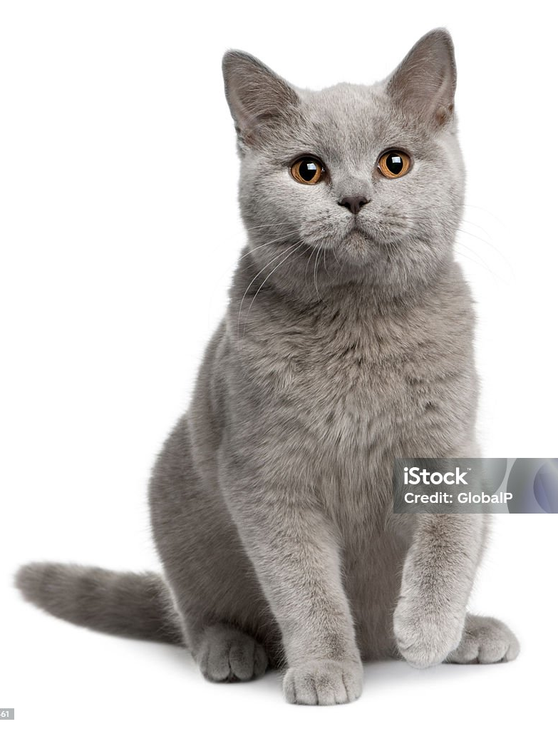

Guess who's in the picture
https://www.istockphoto.com/ru/фото/вид-спереди-британская-американская-короткошёрстная-кошка-7-месяцев-сидя-gm104355461-12964999?phrase=cat&searchscope=image%2Cfilm
https://www.istockphoto.com/ru/фото/золотой-ретривер-сидя-в-перед-белый-фон-с-gm513133900-87483185?phrase=dog&searchscope=image%2Cfilm
How do you distinguish cat and dog?
Can you suggest a formula?

Slide 40
Sentiment analysis
Are these phrases positive or negative?
"I really like this tool!"
"It is better than nothing."
"I can't say that I like it."
How did you understand it?

Slide 41
Sentiment analysis
$x$ – an input text.
$f(x)$ – algorithm that returns text sentiment:
$+1$ for positive, $-1$ for negative

Slide 42
Sentiment analysis
$x$ – an input text.
$f(x)$ – algorithm that returns text sentiment:
$+1$ for positive, $-1$ for negative
Can't program $f(x)$ explicitly

Slide 43
Sentiment analysis
$x$ – an input text.
$f(x)$ – algorithm that returns text sentiment:
$+1$ for positive, $-1$ for negative
Can't program $f(x)$ explicitly
Can collect a lot of reviews with sentiment labels
Use them to find an approximate solution

Slide 44
How Machine Learning works
Programming
Data
Computer
Outputs
Algorithm

Slide 45
How Machine Learning works
Programming
$$4$$
Computer
$$12$$
$$f(x)=3x$$

Slide 46
How Machine Learning works
Programming
Data
Computer
Outputs
Algorithm
Machine Learning
Data
Computer
Algorithm
Outputs

Slide 47
Distinguish cats from dogs
Data
Output
cat dog cat
Computer
Algorithm

Slide 48
Distinguish cats from dogs
Data
Output
cat dog cat
Computer
Algorithm
dog

Slide 49
Machine Learning examples
Translation:
Input – text in the source language
Output – its translation
Recommendations:
Input – user's usage history
Output – piece of content

Slide 50
Machine Learning examples
Voice Assistant:
Input – user's query
Output – answer for this query
Advertisement:
Input – search and purchase history
Output – advertisement of relevant product

Slide 51
Summary
Machine learning is used in many areas.
We want to find an algorithm that will employ the dependencies in data to make predictions.
Approximate predictions are enough.

Slide 52
Basic definitions

Slide 53



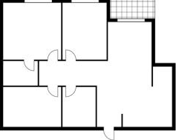
Apartment Pricing
We a company that buys and sells apartments.
How can we estimate the price of the apartment?
Price depends on many parameters.
–
+
https://stock.adobe.com/ru/images/иконка-человека-бизнесмена-в-костюме-с-кейсом.-векторная-иллюстрация./182263887
https://img.freepik.com/premium-vector/coin-vector-icon-yellow-gold-money-symbol_178156-350.jpg
https://ru.freepik.com/premium-vector/financial-arrows-up-and-down-green-and-red-arrow-increase-and-decrease_49432690.htm

Slide 54
Apartment Pricing
$X$ – object set
$x∈X$ – object (e. g. apartment)

Slide 55
Apartment Pricing
$X$ – object set
$x∈X$ – object (e. g. apartment)
$Y$ – label set
$y∈Y$ – label/target for object $x$ (e. g. price)
$Y=\{y_{i}\}_{i=1}^{ℓ}$ – list of labels

Slide 56
Apartment Pricing
$X$ – object set
$x∈X$ – object (e. g. apartment)
$Y$ – label set
$y∈Y$ – label/target for object $x$ (e. g. price)
$Y=\{y_{i}\}_{i=1}^{ℓ}$ – list of labels
$X=\{x_{i},y_{i}\}_{i=1}^{ℓ}$ – training dataset

Slide 57
Apartment Pricing
year of construction | has gas? | living area (m²) | city | price (thou $)
1995 | True | 63 | London | 202
1983 | False | 82 | New York | 376
$$x_{1}$$
$$y_{1}$$
$$x_{2}$$
$$y_{2}$$
Features
Target $(Y)$
Features – characteristics of an object $(x)$.

Slide 58
Model
$a$ – model/algorithm
$a(x)≈y$ maps objects into targets
function that outputs prediction for a given object
We want predictions of $a(x)$ to be as close to target value $y$ as possible.

Slide 59
Apartment Pricing
living area (m²) | year of construction | distance to subway (km) | price (thou $)
63 | 1995 | 1.2 | 202
82 | 1983 | 2.3 | 376
$$x_{1}$$
$$y_{1}$$
$$x_{2}$$
$$y_{2}$$
$$\begin{matrix}a(x)=w_{0} & +w_{1}⋅[\text{living area}] \\ & +w_{2}⋅[\text{year of construction}] \\ & +w_{3}⋅[\text{distance to subway}]\end{matrix}$$
For a given house $\overset{˜}{x}$ we want $a(\overset{˜}{x})≈\overset{˜}{y}$

Slide 60
Parameters and Hyperparameters
Parameters:
Everything in the model $a$ that we learn from data
Hyperparameters:
Configurations of $a$ and training procedure that is determined before learning starts.

Slide 61
Example
living area (m²) | price (thou $)
63 | 202
82 | 376
$$x_{1}$$
$$y_{1}$$
$$x_{2}$$
$$y_{2}$$
$$\begin{matrix}a(x) & =w_{0}+w_{1}⋅[\text{living area}] \\ & +w_{2}⋅[\text{living area}]^{2}+…+w_{p}⋅[\text{living area}]^{p}\end{matrix}$$
Weights $w_{0},…,w_{p}$ – parameters
Degree of a polynomial $p$ – hyperparameter

Slide 62
Loss function
For a given object $x$ we want $a(x)≈y$.

Slide 63
Loss function
For a given object $x$ we want $a(x)≈y$.
$l(a(x),y)$ – error function. It measures how different $a(x)\text{is from}y$.

Slide 64
Loss function
For a given object $x$ we want $a(x)≈y$.
$l(a(x),y)$ – error function. It measures how different $a(x)\text{is from}y$.
Loss function measures average error over the whole dataset $X$.
$$L(a,X)=\frac{1}{|X|}\overset{|X|}{\underset{i=1}{∑}}l(a(x_{i}),y_{i})$$

Slide 65
Loss function examples
For a given object $x$ we want $a(x)≈y$.
Mean Squared Error (MSE):
$$l(a(x),y)=(a(x)-y)^{2}$$
$$L(a,X)=\frac{1}{|X|}\overset{|X|}{\underset{i=1}{∑}}(a(x_{i})-y_{i})^{2}$$

Slide 66
Training the model
Train dataset $X$
Model $a$ with some parameters
Loss function $L(a,X)$

Slide 67
Training the model
Train dataset $X$
Model $a$ with some parameters
Loss function $L(a,X)$
Find the best parameters of $a$ that minimise $L(a,X)$
$$a^{*}=\underset{a}{argmin}L(a,X)$$

Slide 68
Example: Training the model
Train dataset $X$: $({\text{living area}}_{i},{\text{price}}_{i})_{i=1}^{ℓ}$
Model: $a(\text{living area})=w_{0}+w_{1}⋅[\text{living area}]$
Loss function:
$$L(a,X)=\frac{1}{ℓ}\overset{ℓ}{\underset{i=1}{∑}}(a(x_{i})-y_{i})^{2}$$
Find the best values $w_{0}$ and $w_{1}$ that minimise $L(a,X)$
$$\frac{1}{ℓ}\overset{ℓ}{\underset{i=1}{∑}}a({\text{area}}_{i})-{\text{price}}_{i})^{2}→\min_{w_{0},w_{1}}$$

Slide 69
Measure Quality
Have:
Train dataset $X$
Trained model $a$
The value of $L(a,X)$ does't measure the real performance.
We should measure quality on unseen (test) dataset $X_{test}$

Slide 70
Metrics
Loss function is hard to interpret.
$$L(a,X)=\frac{1}{ℓ}\overset{ℓ}{\underset{i=1}{∑}}(a(x_{i})-y_{i})^{2}$$
How good the model is if $L(a,X)=100$?
Metrics are used to directly measure the quality of a model.

Slide 71
Metrics: Example
Root Mean Squared Error (RMSE):
$RMSE(a,X)=\sqrt{\frac{1}{ℓ}\overset{ℓ}{\underset{i=1}{∑}}(a(x_{i})-y_{i})^{2}}$
If $RMSE(a,X)=100$, then $a(x)=y±100$

Slide 72
Metrics: Example
R-squared ($R^{2}$):
$$\begin{matrix}R^{2}(a,X) & =1-\frac{MSE(a,X)}{MSE(\overline{Y},X)} \\ & =1-\frac{∑_{i=1}^{ℓ}(a(x_{i})-y_{i})^{2}}{∑_{i=1}^{ℓ}(\overline{Y}-y_{i})^{2}}\end{matrix}$$
where $\overline{Y}=\frac{1}{ℓ}\overset{ℓ}{\underset{i=1}{∑}}y_{i}$
$R^{2}(a,X)∈[0,1]$

Slide 73
Machine Learning Pipeline
Train Data
Model Training
Loss Function
Model with optimal parameters
Model

Slide 74
Machine Learning Pipeline
Train Data
Model Training
Loss Function
Model with optimal parameters
Model
Model Testing
Test Data
Metric
Performance

Slide 75
Summary
Dataset – list of all objects paired with their labels.
Model predicts a label of a given object.
Loss function calculates how wrong the model is. Use on the train dataset.
Metric measured the model's quality. Use on the test dataset.

